Slide 1
HTML

Slide 2
HTML - Session - 1
HTML Basics
Elements, Tags and Attributes
HTML Text
Notes:
Hello Ladies and Gentlemen and Boys and Girls, Welcome Web Development basics,This is Mccarthy Instructor, I’ll give you basic html and css classes. After a long and tiring journey with python, HTML and CSS are gonna be your relaxation.
HTML and CSS are two of the core technologies for building Web pages. HTML provides the structure of the page, CSS the (visual and aural) layout, for a variety of devices. Along with graphics and scripting, HTML and CSS are the basis of building Web pages and Web Applications.

Slide 3
Basics of HTML
What is HTML?
History of HTML
HTML Page Structure
A Simple HTML Document
Notes:
As can be understood from the curriculum, we will make applications by touching on the basic concepts of HTML. However, we will not go into details.
As for the reason we included this course: Everyone working in the field of IT should have at least a basic knowledge of HTML.
Apart from this, we may have to report the results of our operations in the fields of expertise that we will gain in the future, in the simplest way, in HTML. For these reasons, we will discuss the basic issues without going into details.

Slide 4

Did you finish HTML pre-class material?
Notes:
Before starting the lesson, please state whether you have finished the pre-class activity or not on Pear Deck.
🍐 This is a Pear Deck Multiple Choice Slide. Your current options are: A: Yes, B: No,
🍐 To edit the type of question or choices, go back to the "Ask Students a Question" in the Pear Deck sidebar.

Slide 5
What does “HTML” stand for?
Notes:
Yes, our first question: What does HTML stand for? Please give our answers on Pear Deck.
🍐 This is a Pear Deck Text Slide
🍐 To edit the type of question, go back to the "Ask Students a Question" in the Pear Deck sidebar.

Slide 6
What is the HTML?
Notes:
Yes, now we can start our lesson with what HTML is.
HTML is the code that is used to structure a web page and its content.

Slide 7

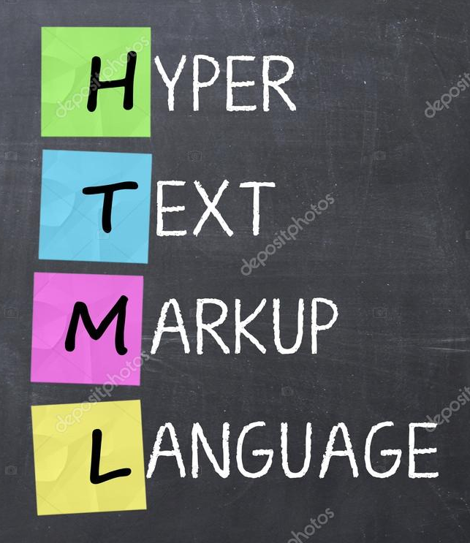
What is HTML?
Notes:
HTML is an acronym which stands for Hyper Text Markup Language which is used for creating web pages and web applications.
HTML, short for Hypertext Markup Language, allows users to create structure profiles, paragraphs, titles, links, and block quotes for web pages and applications.
It is a universal software language that converts source code into a format that web browsers can read.
It is the main computer language used for design and template creation.
We need this markup language to prepare web pages. We don't need to be programmers to do this.
Because html is not a programming language, it is only the data itself.
HTML cannot be defined as a programming language. Because a program that works on its own with HTML codes cannot be written.
However, programs that can work through programs that can interpret this language can be written. This is exactly why it is not called a programming language.
—---------------------------------
Hypertext (English hypertext) are documents with advanced features that are not just text, displayed on a computer screen or other electronic devices. Hypertext can reference other texts and sources with hyperlinks. Unlike standard texts (English text), images, photographs, videos, tables, mathematical formulas, etc. They can offer content. Hypertext is one of the core concepts of the World Wide Web, and the vast majority of today's Web sites use Hypertext Markup Language (HTML).
Markup language is an artificial language that contains instructions on how to structure or format text. Today, the best known example in the world of information is HTML.
Other known examples include TeX, LaTeX, XML, SGML.

Slide 8
What is HTML?
A markup language defines the structure and presentation of raw text.
A HyperText is text displayed on a computer or device that provides access to other text through links (hyperlinks).
HTML is a markup language used to create documents on the web. It describes the structure and layout of a web page.
Notes:
HTML is the standard markup language for creating Web pages that defines the structure of your content. It consists of a series of elements, which you use to enclose, or wrap, different parts of the content to make it appear or act in a certain way. The enclosing tags can make a word or image hyperlink to somewhere else, can italicize words, can make the font bigger or smaller, and so on.
—----------------------------
Let's take a look at the pages we encounter while browsing the web from a different perspective.
They are all pages made up of articles, pictures, and videos. Their difference from each other is their positioning.
It is the interpretation of the same codes with different usage styles.
HTML allows users to create structure profiles, paragraphs, titles, links, and block excerpts for web pages and applications.
HTML files are documents that end with an .html or .html extension. You can view these files using any internet browser (Google Chrome, Safari or Mozilla Firefox). The browser reads the HTML file and converts it into content that internet users can see.
Generally, an average website contains a variety of different HTML pages. For example, different pages such as homepage, about pages, and contact pages have different HTML documents.

Slide 9
List the Internet Browsers you know by name.
Notes:
Please can you list the Internet browsers you know. You don't have to use it, I want you to list what you know by name.
🍐 This is a Pear Deck Text Slide
🍐 To edit the type of question, go back to the "Ask Students a Question" in the Pear Deck sidebar.

Slide 10
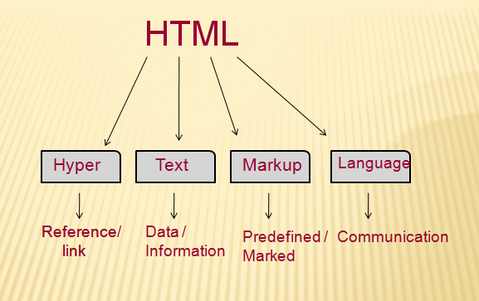
What is HTML?
Notes:
Let's see what is meant by Hypertext Markup Language, and Web page.
Hyper Text: HyperText simply means "Text within Text." A text has a link within it, is a hypertext. Whenever you click on a link which brings you to a new webpage, you have clicked on a hypertext. HyperText is a way to link two or more web pages (HTML documents) with each other.
Markup language: A markup language is a computer language that is used to apply layout and formatting conventions to a text document. Markup language makes text more interactive and dynamic. It can turn text into images, tables, links, etc.
Web Page: A web page is a document which is commonly written in HTML and translated by a web browser. A web page can be identified by entering an URL and can be of the static or dynamic type. With the help of HTML only, we can create static web pages.
Hence, HTML is a markup language which is used for creating attractive web pages with the help of styling, and which looks in a nice format on a web browser. An HTML document is made of many HTML tags and each HTML tag contains different content.
—--------------------------------
Html, the markup language, is the system used in the preparation of web pages. Html, which is not a programming language, is used in the creation of websites that we use on our computers.
Browsers such as Chrome, Safari, Firefox and Opera process html codes and convert these codes into web pages.
# HTML files are documents that end with an .htm or .html extension. You can view these files using any internet browser (Google Chrome, Safari or Mozilla Firefox, Opera). The browser reads the HTML file and converts it into content that internet users can see.

Slide 11
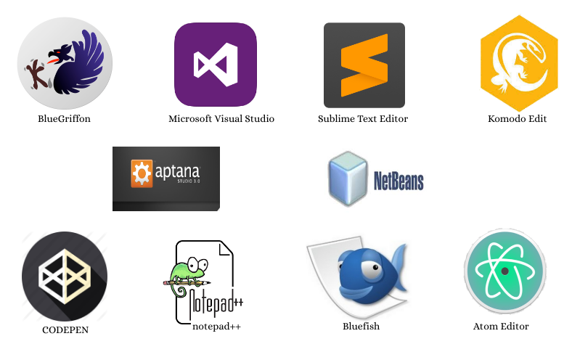

What is HTML?
VS code
Notes:
It is not necessary to install a program on computers to write html code. HTML pages can be created with a text editor such as wordpad, notepad, atom or word.

Slide 12

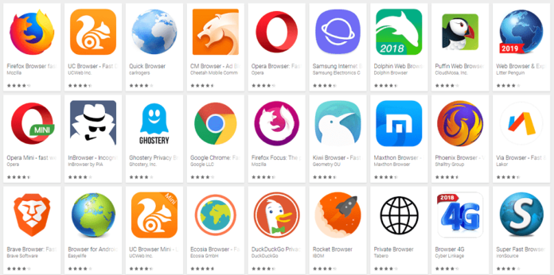
What is HTML?
+
Notes:
Many different tools such as Dreamwear, Sublime Text or notepad ++ can be used to make coding easier. We recommend Visual Studio Code as an html editor.
When saving the written html codes, it must be saved as htm, xhtml or html so that browsers can understand.

Slide 13
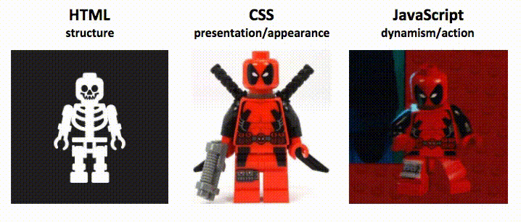
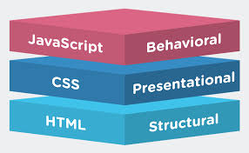
What is HTML?
Notes:
HTML is the markup language that we use to structure and give meaning to our web content, for example defining paragraphs, headings, and data tables, or embedding images and videos in the page.
CSS is a language of style rules that we use to apply styling to our HTML content, for example setting background colors and fonts, and laying out our content in multiple columns.
We can say, HTML is the text markup language that forms the skeleton of websites, can even work when written into a text document and opened from the browser.
CSS (Cascade Style Sheet) gives the shape and image of an HTML document. In other words, CSS is a text sculpting language that saves HTML from being a simple skeleton. Therefore it is of great importance.
Javascript is on the other hand, a programming language. It is used on websites and some game engines. More dynamic web interfaces or calculations can be made with Javascript. Actions such as what to do when a button is pressed, automatic completion when writing a text in a text field are done with Javascript. In addition, operations such as graphing the obtained instant data, mathematical calculations and even making games are also performed with Javascript.

Slide 14
What is HTML?
Notes:
JavaScript is a scripting language that enables you to create dynamically updating content, control multimedia, animate images, and pretty much everything else.
In short; While HTML enables you to add content to a web page, CSS determines the design, style and layout of web pages. JavaScript manages the behavior of web pages, adding vitality to them.

Slide 15
History of HTML
Notes:
HTML is a very evolving markup language and has evolved with various versions updating. Long before its revised standards and specifications are carried in, each version has allowed its user to create web pages in a much easier and prettier way and make sites very efficient.

Slide 16
History of HTML
What is the latest HTML version?
(Please answer the question on Pear Deck)
Notes:
What is the latest HTML version? Please give your answers from Pear Deck.
🍐 This is a Pear Deck Multiple Choice Slide. Your current options are: A: HTML 3, B: HTML 4, C: HTML 5, D: HTML 6,
🍐 To edit the type of question or choices, go back to the "Ask Students a Question" in the Pear Deck sidebar.

Slide 17
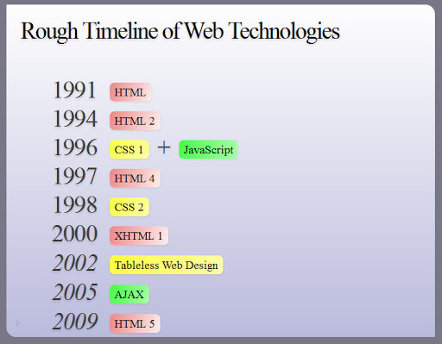
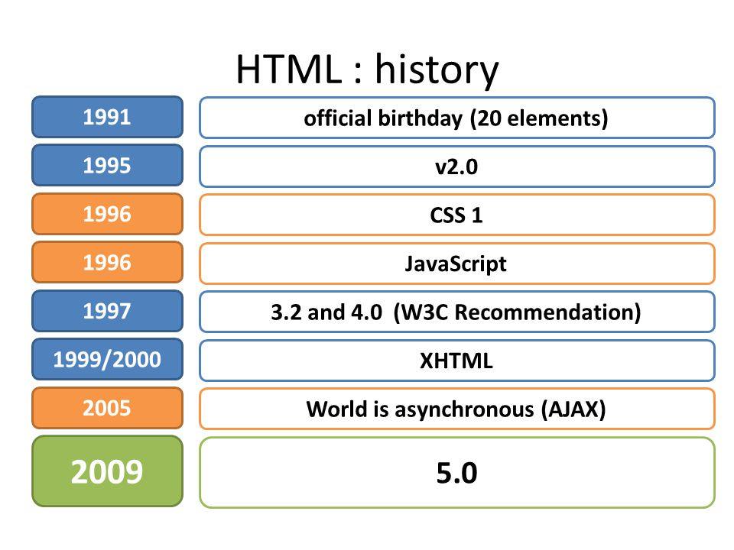
History of HTML
Notes:
The journey that started in 1991 reached the year 2009 with the addition of new versions released in different years, and in 2009, the HTML 5 version was reached and ratified as a standard in October of 2014.
While HTML evolving, other technologies such as CSS and JavaScript are also evolving with it.
Web sites have been brought to life with the addition of CSS and JavaScript to this journey in 1996.

Slide 18


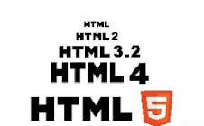
History of HTML
HTML5 2014
XHTML 2000
HTML 4.0.1 1997
HTML 3.2 1996
HTML 2.0 1994
HTML * 1991 **
* Version ** Year
Notes:
Web standards are the technologies we use to build web sites. These standards exist as long technical documents called specifications, which detail exactly how the technology should work.
Web standards are created by standards bodies — institutions that invite groups of people from different technology companies to come together and agree on how the technologies should work in the best way to fulfill all of their use cases. The W3C is the best known web standards body, but there are others such as the WHATWG (who maintain the living standards for the HTML language), ECMA (who publish the standard for ECMAScript, which JavaScript is based on), Khronos (who publish technologies for 3D graphics, such as WebGL), and others.
https://www.w3.org/
The World Wide Web Consortium (W3C) is an international community where Member organizations, a full-time staff, and the public work together to develop Web standards. Led by Web inventor and Director Tim Berners-Lee and CEO Jeffrey Jaffe, W3C mission is to lead the World Wide Web to its full potential by developing protocols and guidelines that ensure the long-term growth of the Web.
—--------------------
Due to the rapid increase in popularity, HTML is now considered an official web standard. HTML features are controlled and developed by the World Wide Web Consortium (W3C).
The latest innovations in HTML language can be checked on the website of the World Wide Web Consortium.
The World Wide Web Consortium (W3C) is an international community that develops open standards to ensure the long-term growth of the Web.

Slide 19
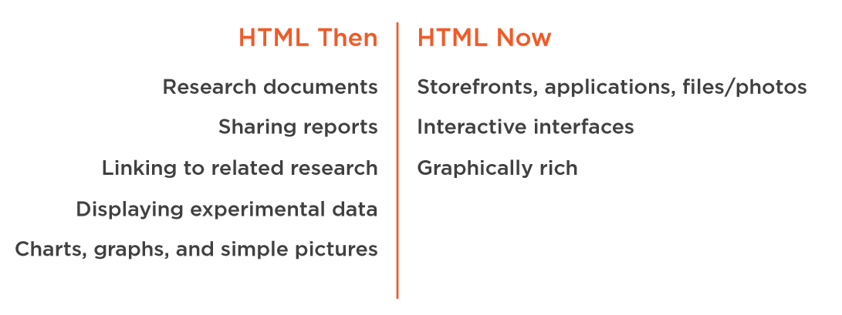
History of HTML
Notes:
HTML, which was used for basic tasks such as sharing research documents and reports, links to different investigations, display of experimental data, display of graphics and simple images in the first years of use, today supports all kinds of advanced content on the internet.

Slide 20
History of HTML
It is still possible to visit the first web page on Internet.
(Please answer the question on Pear Deck)
Notes:
It is still possible to visit the first website created on the Internet. Please mark your answers on Pear Deck as true or false.
🍐 This is a Pear Deck Multiple Choice Slide. Your current options are: A: True, B: False,
🍐 To edit the type of question or choices, go back to the "Ask Students a Question" in the Pear Deck sidebar.

Slide 21
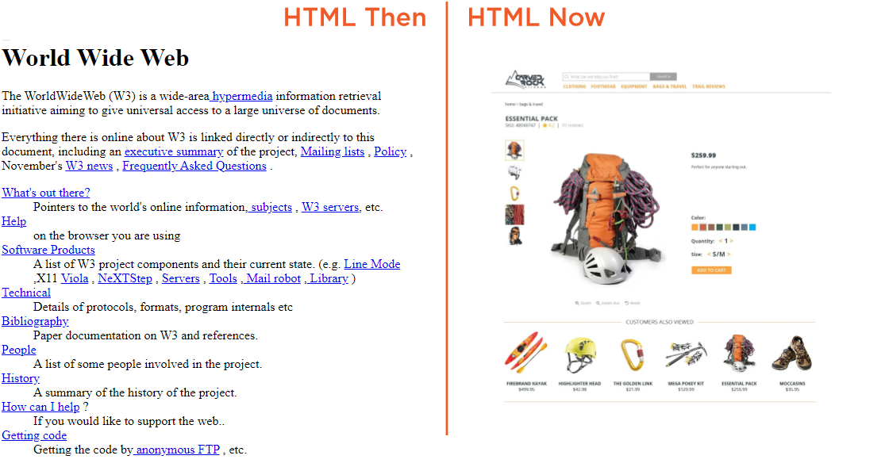
History of HTML
http://info.cern.ch/hypertext/WWW/TheProject.html
Notes:
The first website, which is still accessed by CERN on the internet and seen to the left of the half, was published on August 6, 1991.
It is possible to access the site from the address. On the right is an example from today's pages.
First HTML page: http://info.cern.ch/hypertext/WWW/TheProject.html
Modern sites: https://swabtheworld.com/en/
https://spotify.design/
https://www.amazon.com/

Slide 22
HTML Page Structure
Notes:
Yes, after this general knowledge, we can gradually move on to technical information.

Slide 23
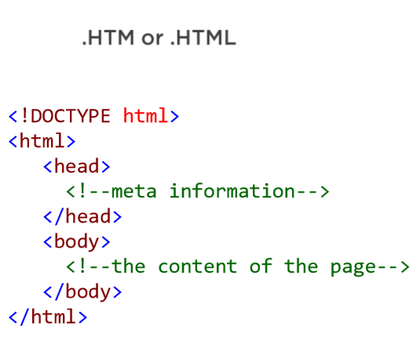
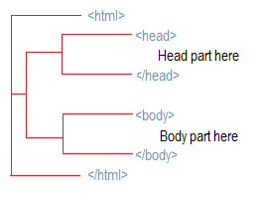
HTML Page Structure
Notes:
HTML files are documents that end with an .htm or .html extension. You can view these files using any internet browser (Google Chrome, Safari or Mozilla Firefox).
The browser reads the HTML file and converts it into content that internet users can view.
An HTML document is composed of three parts:
a line containing HTML version information,
a declarative header section (delimited by the HEAD element),
a body, which contains the document's actual content.
White space (spaces, newlines, tabs, and comments) may appear before or after each section.

Slide 24
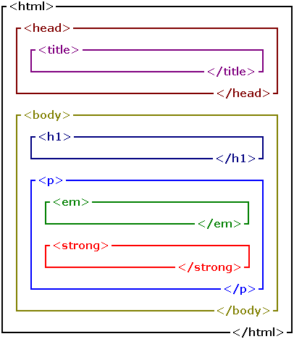
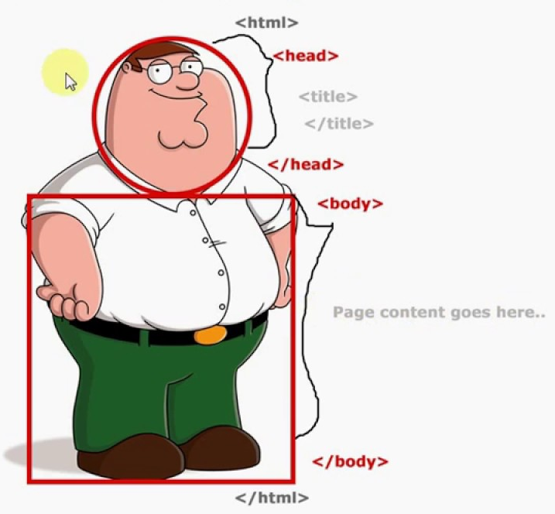
HTML Page Structure
Notes:
An HTML document is a plaintext document structured with elements. Elements are surrounded by matching opening and closing tags. Each tag begins and ends with angle brackets (<>). There are a few empty or void tags that cannot enclose any text, for instance <img>.
—-----------------
Different tags and elements are placed between <head> and <body> tags to form the final document. The actual content is inside the <body> element.

Slide 25
A Simple HTML Document
Notes:
Creating and editing HTML documents is easy.
—---------------
After seeing the HTML page structures briefly, let's examine a simple HTML document.

Slide 26
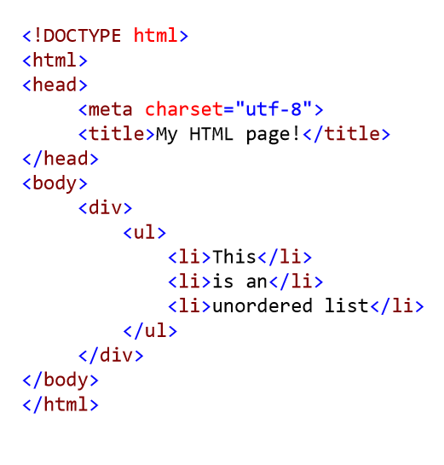
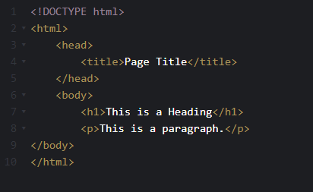
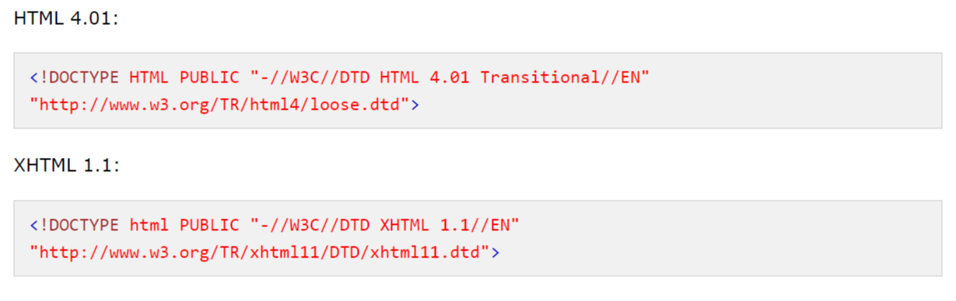
A Simple HTML Document
Notes:
A basic level HTML document is like on the view
All HTML documents must start with a <!DOCTYPE> declaration.
The declaration is not an HTML tag. It is an "information" to the browser about what document type to expect.

Slide 27
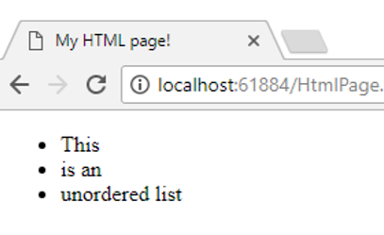
A Simple HTML Document
Notes:
The <html> tag represents the root of an HTML document. The <html> tag is the container for all other HTML elements (except for the <!DOCTYPE> tag).
The <head> element is a container for metadata (data about data) and is placed between the <html> tag and the <body> tag.
Metadata is data about the HTML document and is not displayed.
Metadata typically define the document title, character set, styles, scripts, and other meta information.
**************************
The following elements can go inside the <head> element:
<title> (required in every HTML document)
<style>
<base>
<link>
<meta>
<script>
<noscript>
—-----------------
After the DOCTYPE definition, our document starts with the <html> tag.
The <head> element contains some metadata definitions and additional tags.
Then it goes to the <body> section where the content is located.

Slide 28

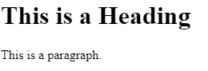
A Simple HTML Document
Notes:
The <body> tag defines the document's body.
The <body> element contains all the contents of an HTML document, such as headings, paragraphs, images, hyperlinks, tables, lists, etc.
Note: There can only be one <body> element in an HTML document.
—-------------------
The main content of the document is contained within the <body> element.

Slide 29
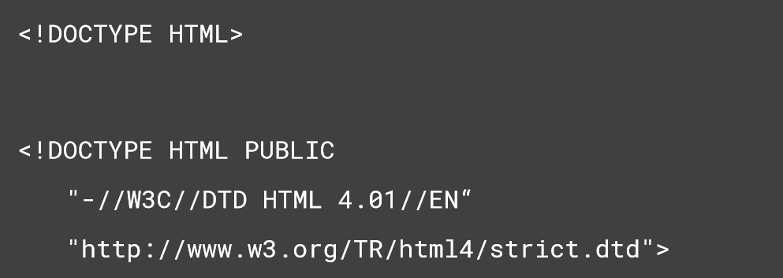
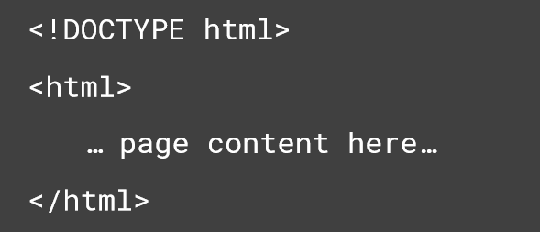
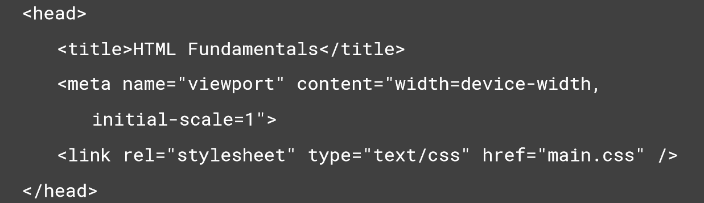
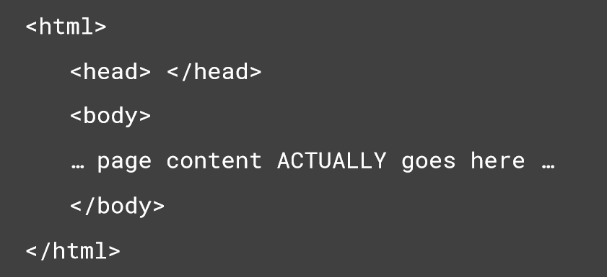
A Simple HTML Document
The DOCTYPE indicates the standards compliance or version of the document
The HTML element act as the root of the document
The HEAD element contains document metadata
The BODY element contains the content to be displayed
Notes:
We can briefly summarize that:
Doctype: Specifies the version of the document.
Html is a tag that means we will code in the html language that we have to open at the beginning of the document and close at the end.
Head is the tag containing information and definitions about the document. Style arrangements can also be found here.
Body is the tag in which the document is written in the design area, gives the field information and contains all kinds of content.

Slide 30
A Simple HTML Document
Which one is not an HTML element?
(Please answer the question on Pear Deck)
Notes:
Which of them is not an HTML element?
🍐 This is a Pear Deck Multiple Choice Slide. Your current options are: A: <doctype>, B: <html>, C: <head>, D: <body>, E: <title>,
🍐 To edit the type of question or choices, go back to the "Ask Students a Question" in the Pear Deck sidebar.

Slide 31
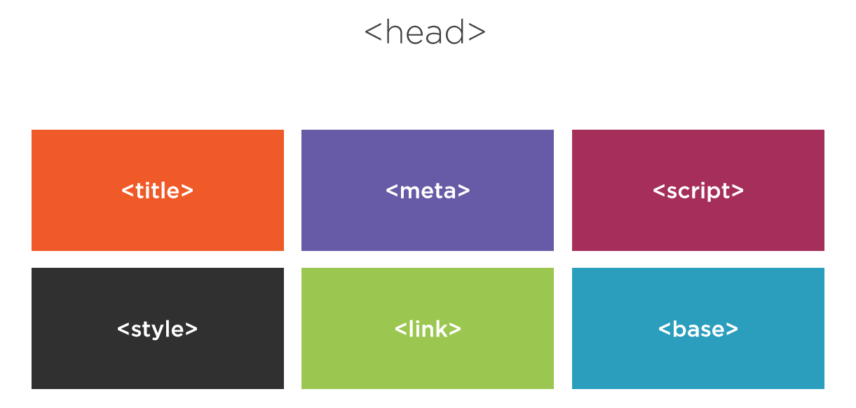
A Simple HTML Document
Notes:
The <meta> tag defines metadata about an HTML document. Metadata is data (information) about data.
<meta> tags always go inside the <head> element, and are typically used to specify character set, page description, keywords, author of the document, and viewport settings.
Metadata will not be displayed on the page, but is machine parsable.
Metadata is used by browsers (how to display content or reload page), search engines (keywords), and other web services.
<base>The HTML <base> element specifies the base URL to use for all relative URLs in a document.
<head>The HTML <head> element contains machine-readable information (metadata) about the document, like its title, scripts, and style sheets.
<link>The HTML External Resource Link element (<link>) specifies relationships between the current document and an external resource. This element is most commonly used to link to stylesheets, but is also used to establish site icons (both "favicon" style icons and icons for the home screen and apps on mobile devices) among other things.
<meta>The HTML <meta> element represents metadata that cannot be represented by other HTML meta-related elements, like <base>, <link>, <script>, <style> or <title>.
<style>The HTML <style> element contains style information for a document, or part of a document.
<title>The HTML Title element (<title>) defines the document's title that is shown in a browser's title bar or a page's tab.

Slide 32
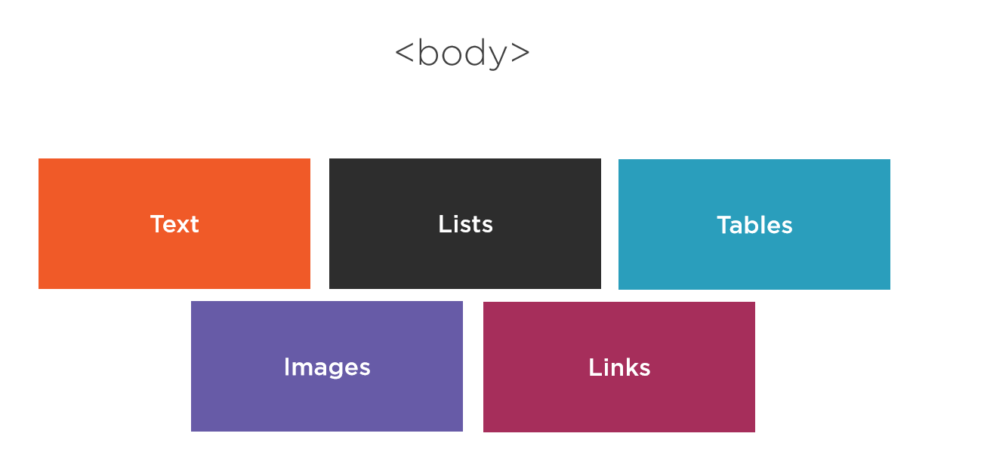
A Simple HTML Document
Notes:
Body can include different types of elements listed on the slide.

Slide 33
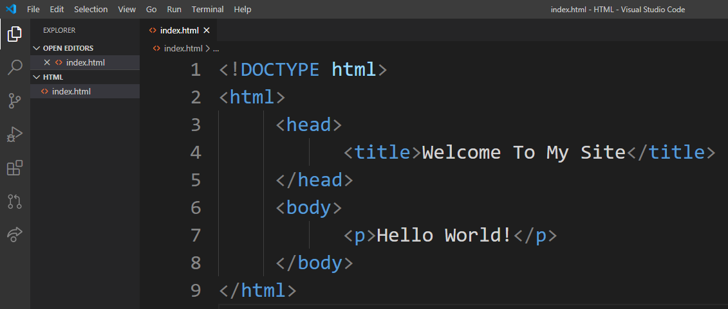

Creating “Hello World” HTML File on VS Code
Notes:
Now let’s create our first html document.
<!DOCTYPE html>
<html>
<head> <title>Welcome To My Site</title>
</head>
<body>
<p>Hello World!</p>
</body>
</html>

Slide 34


Slide 35
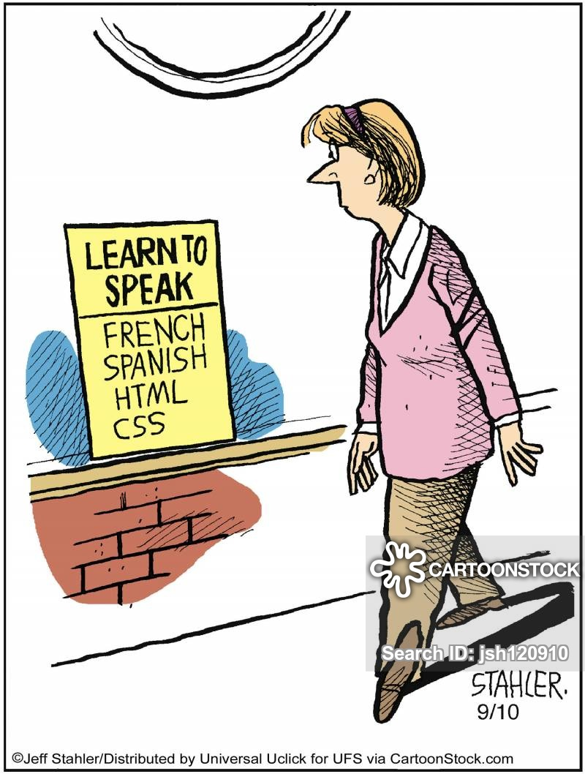
HTML
Elements, Tags
and Attributes
Notes:
Now we will continue with a little more technical information.

Slide 36
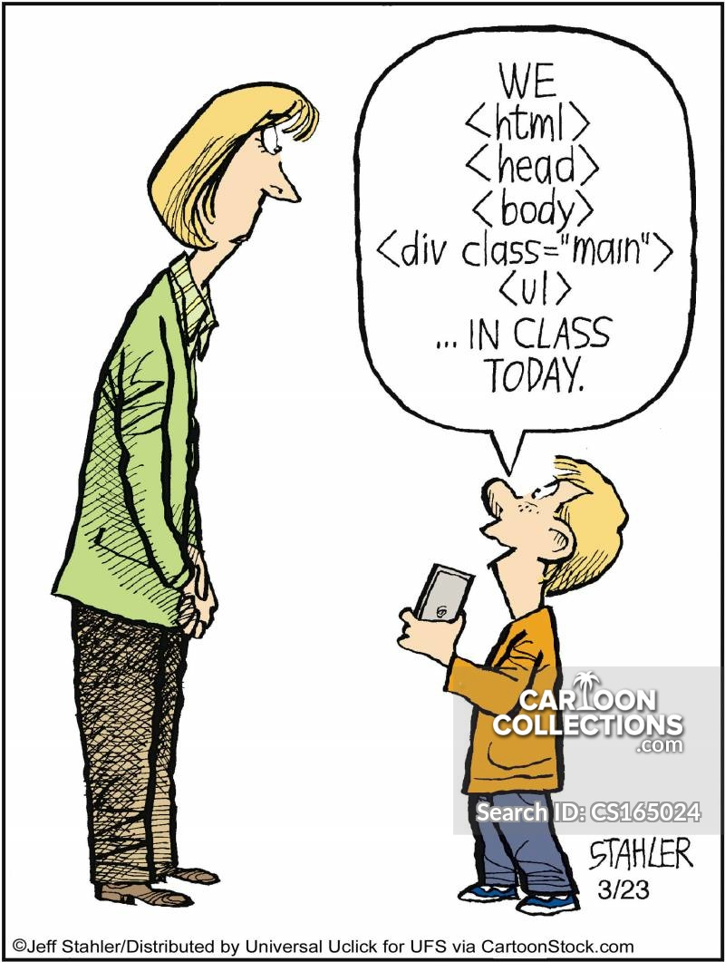
Please define
HTML element
HTML tag
HTML attribute
shortly!
Notes:
Before starting the lesson, please explain briefly what you understand when you say HTML element, tag and attribute on Pear Deck.
🍐 This is a Pear Deck Text Slide
🍐 To edit the type of question, go back to the "Ask Students a Question" in the Pear Deck sidebar.

Slide 37
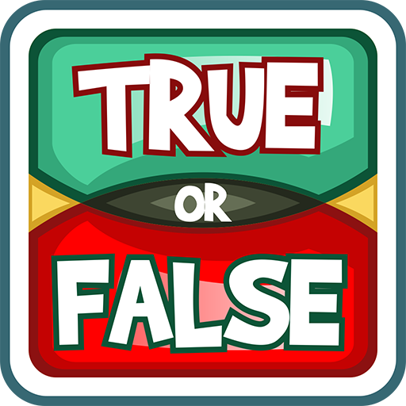
HTML elements can’t be nested.
Notes:
HTML elements cannot be nested. Is it true or false? Please let's answer it on Pear Deck.
🍐 This is a Pear Deck Multiple Choice Slide. Your current options are: A: True, B: False,
🍐 To edit the type of question or choices, go back to the "Ask Students a Question" in the Pear Deck sidebar.

Slide 38
Table of Contents
HTML Elements
Nested HTML Elements
Empty HTML Elements
Tags
Attributes
Notes:
We will first explain a little theory and then practice. In the theory part, we will first discuss the HTML elements, then explain the tags and attributes.

Slide 39
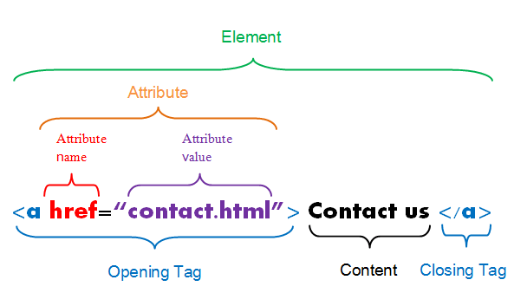
HTML Elements
Notes:
An HTML element is an individual component of an HTML document. It represents semantics, or meaning. For example, the title element represents the title of the document.
Most HTML elements are written with a start tag (or opening tag) and an end tag (or closing tag), with content in between. Elements can also contain attributes that defines its additional properties.
—-------------------
Let's start our lesson with HTML elements.

Slide 40
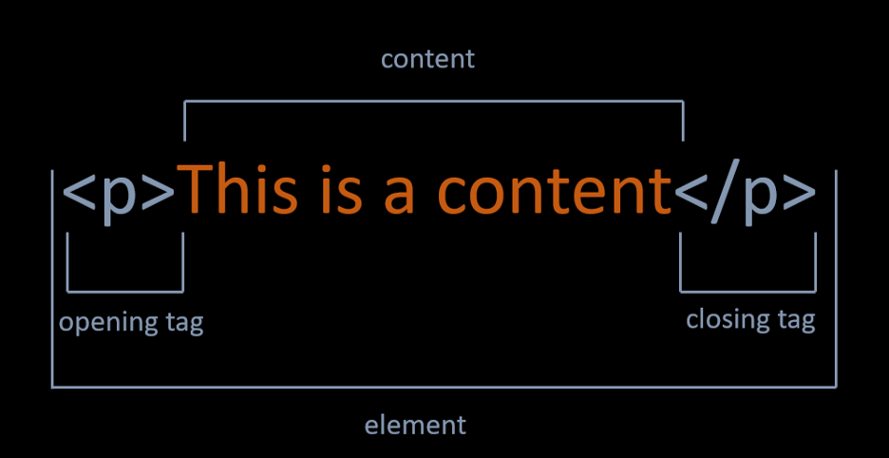
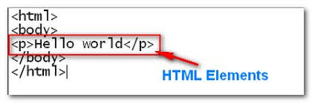
HTML Elements
Notes:
In the example on the slide, the <p> is the opening tag and the p with a forward slash is the closing tag, and the phrase "This is a content" is the content.
In the next picture, similarly, a paragraph element whose content is "Hello World" is seen.
1) The HTML element starts with the start tag and ends with the end tag.
2) Everything between the start and end tags is called element contents.
3) Some HTML elements may contain empty content.
4) Most HTML elements have attributes.

Slide 41
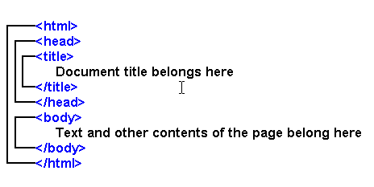
Nested HTML Elements
Notes:
HTML elements can be nested (this means that elements can contain other elements).
All HTML documents consist of nested HTML elements.
—----------------
HTML elements are nested in a structure we call nested.

Slide 42
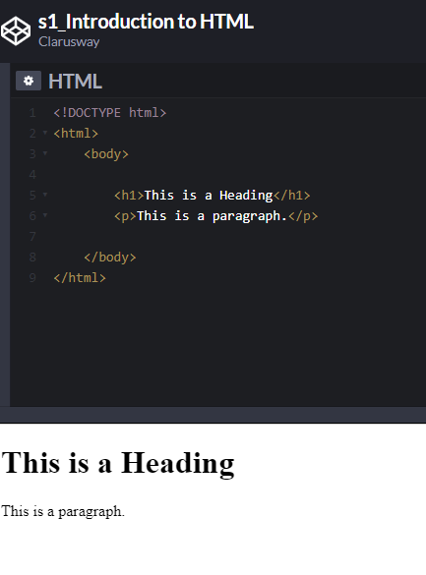
Nested HTML Elements
HTML documents consist of nested HTML elements. HTML elements can contain elements (elements can be nested). All HTML documents composed of nested HTML elements.
HTML Document above contains four HTML elements.
The HTML element includes the body element.
The body element includes the <h1> and <p> elements.
Notes:
Each HTML document consists of nested HTML elements. HTML elements can also be composed of other elements. In fact, it would not be wrong to say that all HTML documents consist of nested HTML elements.
The HTML document on the slide consists of four HTML elements:
The first element in the example is the <html> element and defines the entire document.
All elements up to the closing </html> make up the content of the <html> element.
<body> is the second element.
<h1> and <p> are the third and fourth innermost elements. The content of these elements is the text between the tags.

Slide 43
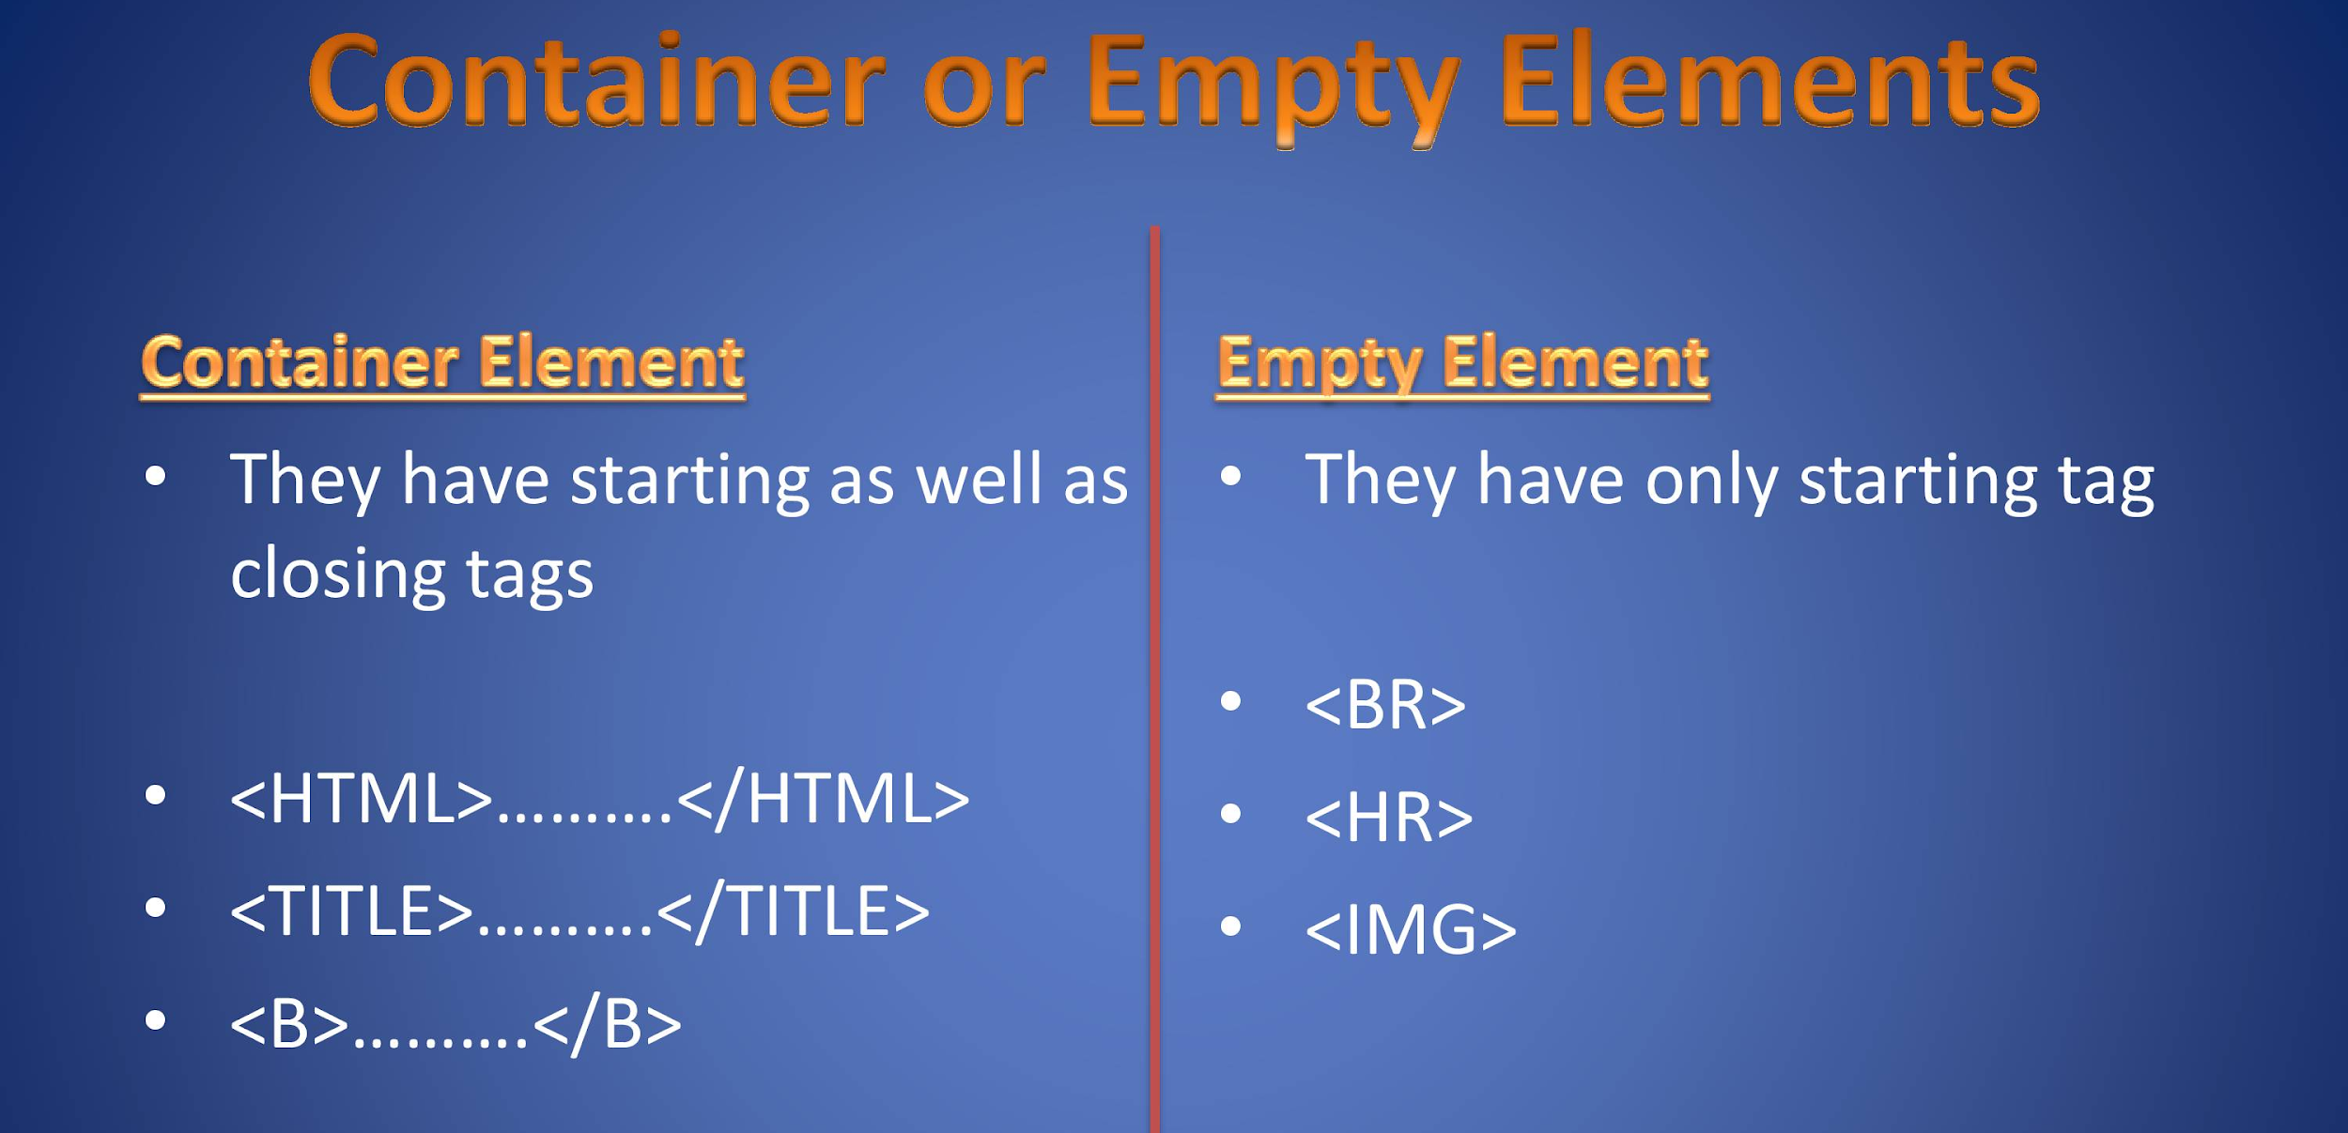
Empty HTML Elements
3
Notes:
There are also empty HTML elements in addition to the elements with its own content.

Slide 44
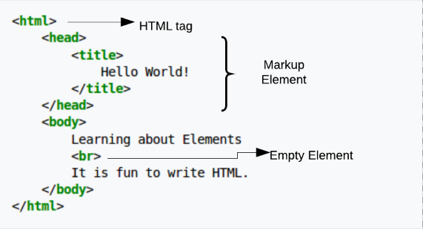
Empty HTML Elements
If a HTML element does not have any content, it is called empty element.
Empty HTML elements do not have a closing tag.
Notes:
If an element has no content of its own, it is called an empty element.
Empty HTML elements do not have closing tags.
The <br> element seen in the slide is an empty element.
The HTML, specifications define very precisely what each element can contain. Many combinations have no semantic meaning, for example an <audio> element nested inside an <hr> element.
The empty elements in HTML are as follows: https://developer.mozilla.org/en-US/docs/Glossary/Empty_element

Slide 45
Which part is the content of body element?
Notes:
Friends, what is the content of the <body> element in the HTML code shown on the slide? Please specify on Pear Deck.
🍐 This is a Pear Deck Text Slide
🍐 To edit the type of question, go back to the "Ask Students a Question" in the Pear Deck sidebar.

Slide 46
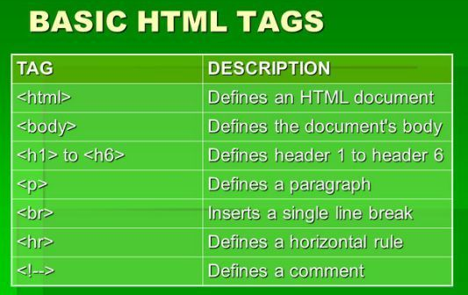
HTML Tags
4
Notes:
Technically, an HTML element is the collection of start tag, its attributes, an end tag and everything in between. On the other hand an HTML tag (either opening or closing) is used to mark the start or end of an element, as you can see on the slide.
—----------------
Now let's briefly touch on HTML tags.

Slide 47
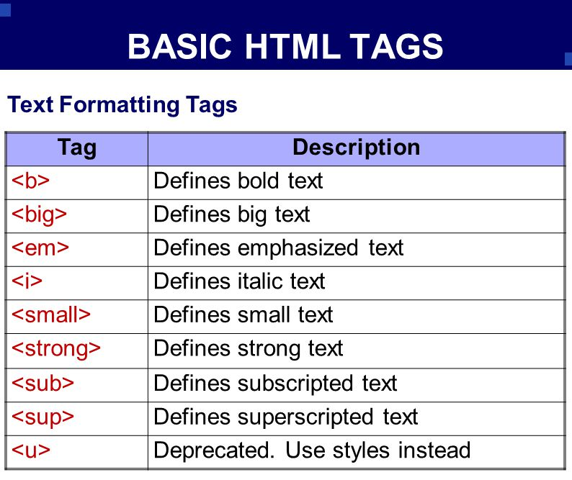
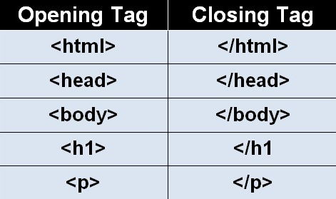
HTML Tags
Notes:
HTML tags are like keywords which defines that how web browser will format and display the content. With the help of tags, a web browser can distinguish between an HTML content and a simple content.
When a web browser reads an HTML document, it reads it from top to bottom and left to right. HTML tags are used to create HTML documents and render their properties. Each HTML tags have different properties.
An HTML file must have some essential tags so that web browser can differentiate between a simple text and HTML text. You can use as many tags you want as per your code requirement.
All HTML tags must enclosed within < > these brackets.
Every tag in HTML perform different tasks.
If you have used an open tag <tag>, then you must use a close tag </tag> (except some tags)
—---------------------
HTML tags have always been important in the history of Web design. In the early days of the World Wide Web, most of the Web code consisted of these elements.
We can define HTML tags, which we can also call tags, as a command line consisting of a series of characters and formatted to create the web page. Tags that form the core of HTML are commands that create the visual structure of web pages and are read by browsers.
HTML tags are placed between angle brackets, ie greater-less than signs. Tag names that appear as abbreviations or words briefly indicate what the related tag works.

Slide 48
<P> means the same as <p> in HTML.
Notes:
Uppercase P and lowercase p have the same meaning in HTML. Is it true or false? Please let's answer it on Pear Deck.
🍐 This is a Pear Deck Multiple Choice Slide. Your current options are: A: True, B: False,
🍐 To edit the type of question or choices, go back to the "Ask Students a Question" in the Pear Deck sidebar.

Slide 49
What is the difference between opening tag and closing tag?
Notes:
What is the difference between the opening tag and the closing tag? Please specify on Pear Deck.
🍐 This is a Pear Deck Text Slide
🍐 To edit the type of question, go back to the "Ask Students a Question" in the Pear Deck sidebar.

Slide 50
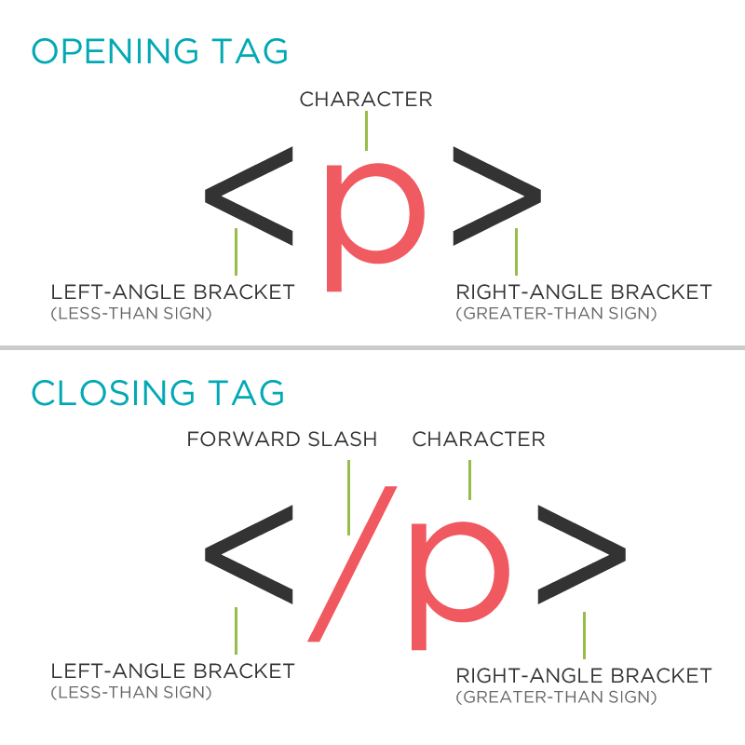
HTML Tags
HTML Is Not Case Sensitive
<P>
means the same as
<p>.
Notes:
Tags have both opening and closing. In addition to the opening, the closing tags carry a forward slash after the less than sign.
Some HTML elements will display correctly even if you forget the closing tags. However, it is an important practice not to forget the closing tags in order to avoid unexpected results.
HTML tags are not case sensitive. <BR/> is the same as <br/>. However, the World Wide Web Consortium (W3C) recommends that the tags be written in small.

Slide 51
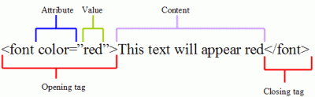
HTML Attributes
Notes:
HTML attributes provide additional information on the content of the element.

Slide 52
HTML Attributes
Notes:
Attributes are additional values that configure the elements or adjust their behavior in various ways to meet the criteria the users want.
An attribute is used to define the characteristics of an HTML element and is placed inside the element's opening tag. All attributes are made up of two parts − a name and a value
The name is the property you want to set. For example, the paragraph <p> element carries an attribute whose name is align, which you can use to indicate the alignment of paragraph on the page.
The value is what you want the value of the property to be set and always put within quotations. For example, three possible values of align attribute: left, center and right.
Attribute names and attribute values are case-insensitive. However, the World Wide Web Consortium (W3C) recommends lowercase attributes/attribute values in their HTML 4 recommendation.
—-------------------
They are always included in the opening tag and consist of a name and a value for that name. There is an equal sign between name and value, namely name and value pair.
HTML Properties
1) Provides additional properties to HTML elements.
2) Properties are defined in the starting tag and usually take value.

Slide 53
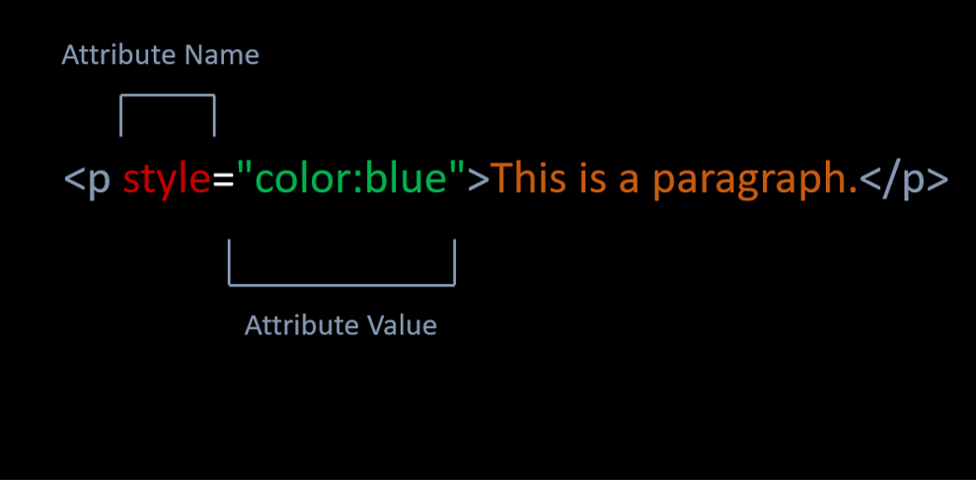
HTML Attributes
Notes:
The four core attributes that can be used on the majority of HTML elements (although not all) are −
Id
Title
Class
Style
The style attribute allows you to specify Cascading Style Sheet (CSS) rules within the element.
—----------
For example, the style attribute specifies the style of the element it belongs to. This color, font, size etc. may be. For example, the color of the style of the paragraph content on the mirror is determined as blue.

Slide 54
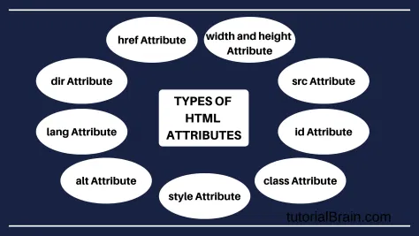
HTML Attributes
Notes:
Double quotes around attribute values are the most common in HTML, but single quotes can also be used.
In some situations, when the attribute value itself contains double quotes, it is necessary to use single quotes:
HTML Attribute List: https://developer.mozilla.org/en-US/docs/Web/HTML/Attributes

Slide 55
Attributes are always specified in the content part.
Notes:
HTML attributes are always found in the content section. Is it true or false? Please let's answer it on Pear Deck.
🍐 This is a Pear Deck Multiple Choice Slide. Your current options are: A: True, B: False,
🍐 To edit the type of question or choices, go back to the "Ask Students a Question" in the Pear Deck sidebar.

Slide 57
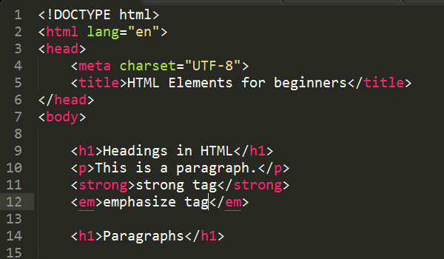
HTML Text
Notes:
HTML contains several elements for defining text with a special meaning.
—----------------------
In this lesson, we will focus on text formatting in HTML.

Slide 58
Table of Contents
Heading
Paragraphs
Horizontal Lines
Line Breaks
Comments

Slide 59
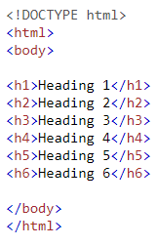
Heading
Notes:
HTML headings are titles or subtitles that you want to display on a webpage.
—--------------
First, we will discuss the topic of Heading.

Slide 60
How many heading styles in HTML?
Notes:
🍐 This is a Pear Deck Multiple Choice Slide. Your current options are: A: 4, B: 5, C: 6, D: 7, E: 8,
🍐 To edit the type of question or choices, go back to the "Ask Students a Question" in the Pear Deck sidebar.

Slide 61
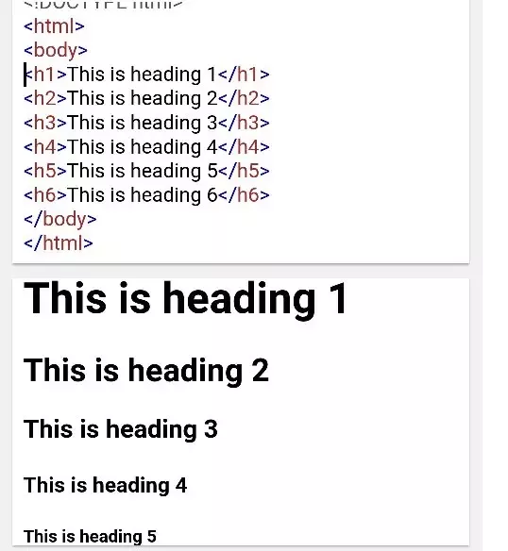
Heading
Notes:
HTML headings are defined with the <h1> to <h6> tags.
<h1> defines the most important heading. <h6> defines the least important heading.
Search engines use the headings to index the structure and content of your web pages.
Headings may be nested as subsections to reflect the organization of the content of the page. Most screen readers can also generate an ordered list of all the headings on a page, which can help a person quickly determine the hierarchy of the content:
—---------------
HTML heading is a very important concept.
We use headings when writing in HTML documents.
These headings inform both the users who visit our website and the search engines about the content of our page.
Headings have 6 different sizes from <h1> tag to <h6> tag.
The <h1> tag is used for the most important title on the page, and the <h6> tag is used for the lowest important title.

Slide 62


Is <h1> the primary heading for document true or false?
True
False
Notes:
🍐 This is a Pear Deck Multiple Choice Slide. Your current options are: A: True, B: False,
🍐 To edit the type of question or choices, go back to the "Ask Students a Question" in the Pear Deck sidebar.

Slide 63


Slide 64
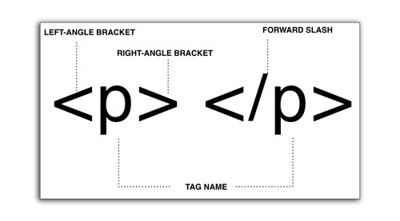
Paragraphs
Notes:
Paragraphs in HTML documents are specified with the <p> tag.

Slide 65
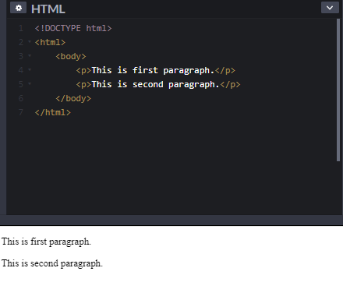
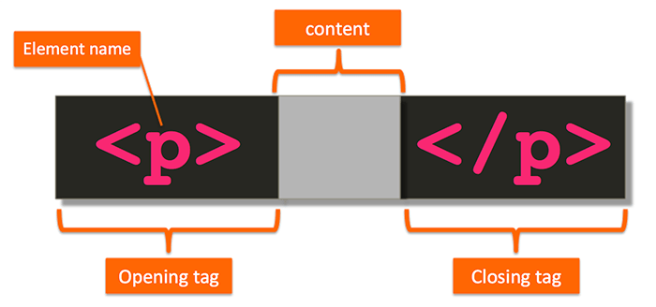
Paragraphs
Notes:
Paragraphs are usually represented in visual media as blocks of text separated from adjacent blocks by blank lines and/or first-line indentation, but HTML paragraphs can be any structural grouping of related content, such as images or form fields.
By default, browsers separate paragraphs with a single blank line.
With HTML, you cannot change the display by adding extra spaces or extra lines in your HTML code.
The browser will automatically remove any extra spaces and lines when the page is displayed. Example below:
<p>
This paragraph
contains a lot of lines
in the source code,
but the browser
ignores it.
</p>
<p>
This paragraph
contains a lot of spaces
in the source code,
but the browser
ignores it.
</p>
—--------------------
Paragraphs make up the main text.
Spaces are automatically found before and after each paragraph.

Slide 67

Horizontal
Lines
Notes:
The <hr> HTML element represents a thematic break between paragraph-level elements: for example, a change of scene in a story, or a shift of topic within a section.
—----------------
Horizontal Lines divide the page horizontally in their position.

Slide 68

Horizontal Lines
Notes:
The <hr> tag is an empty tag, and it does not require an end tag.
—-------------
The horizontal line specified with the <hr> tag is used to separate contents in HTML documents.

Slide 70
HTML Line Breaks
Notes:
The <br> HTML element produces a line break in text (carriage-return). It is useful for writing a poem or an address, where the division of lines is significant.

Slide 71

HTML Line Breaks
Notes:
The text after the <br> begins again at the start of the next line of the text block.
The <br> element has a single, well-defined purpose — to create a line break in a block of text. As such, it has no dimensions or visual output of its own, and there is very little you can do to style it.
The <br> tag is an empty tag which means that it has no end tag.
—------------------
The <br> tag inserts a single line break.
The <br> tag is useful for writing addresses or poems.
The <br> tag is an empty tag which means that it has no end tag.

Slide 72


Slide 73
Which one is not a valid HTML tag?
Notes:
🍐 This is a Pear Deck Multiple Choice Slide. Your current options are: A: <br>, B: <hr>, C: <p>, D: <h>,
🍐 To edit the type of question or choices, go back to the "Ask Students a Question" in the Pear Deck sidebar.

Slide 74
HTML Comments
Notes:
The final topic of this lesson is HTML comments.
HTML comments are not displayed in the browser, but they can help document your HTML source code.

Slide 75


HTML Comments
Notes:
With comments you can place notifications and reminders in your HTML code:
An HTML comment begins with <!–– and the comment closes with ––>. HTML comments are visible to anyone that views the page source code, but are not rendered when the HTML document is rendered by a browser.
Read more: https://html.com/tags/comment-tag/#ixzz7IsMEDWTg
—--------------------
The tag seen on the mirror is used to add comments to HTML documents.
Comments are not displayed in the browser window.
But they are displayed in source code.
For this reason, remember that your comments can be seen by the people who visit the site and view the source of your website.
Instead of deleting the HTML codes you want to deactivate, you can convert them to comments.

Slide 76


Slide 77
Do we need a review?
if so: which part?
Notes:
🍐 This is a Pear Deck Multiple Choice Slide. Your current options are: A: NO, B: Headings, C: <p>, D: <hr>, E: <br>, F: Comments,
🍐 To edit the type of question or choices, go back to the "Ask Students a Question" in the Pear Deck sidebar.

Slide 78
Please summarize
today’s topics in your words!
Notes:
🍐 This is a Pear Deck Text Slide
🍐 To edit the type of question, go back to the "Ask Students a Question" in the Pear Deck sidebar.

Slide 80
THANKS!

Slide 81

Creating our First HTML File

Slide 82
A Simple HTML Document
Everyone is on the same page?
(Please answer the question on Pear Deck)
Notes:
Guys, did everyone understand what has been explained so far? Could we get to the same page right now? Has anyone been able to create a simple "Hello World" HTML document? Please indicate your answer as yes or no.
🍐 This is a Pear Deck Multiple Choice Slide. Your current options are: A: Yes, B: No,
🍐 To edit the type of question or choices, go back to the "Ask Students a Question" in the Pear Deck sidebar.

Slide 83

Creating codepen accounts on codepen.io
https://codepen.io/

Slide 84
Creating codepen accounts on codepen.io
Any problem while creating the codepen accounts?
(Please answer the question on Pear Deck)
Notes:
🍐 This is a Pear Deck Multiple Choice Slide. Your current options are: A: Yes, B: No,
🍐 To edit the type of question or choices, go back to the "Ask Students a Question" in the Pear Deck sidebar.

Slide 85

Creating “Hello World” page on codepen.io

Slide 86

Installing VS Code

Slide 87





Installing VS Code
https://code.visualstudio.com/Download

